Slide 1
October Review Slides 1
Aneesh Batchu
November 4, 2024

Slide 2
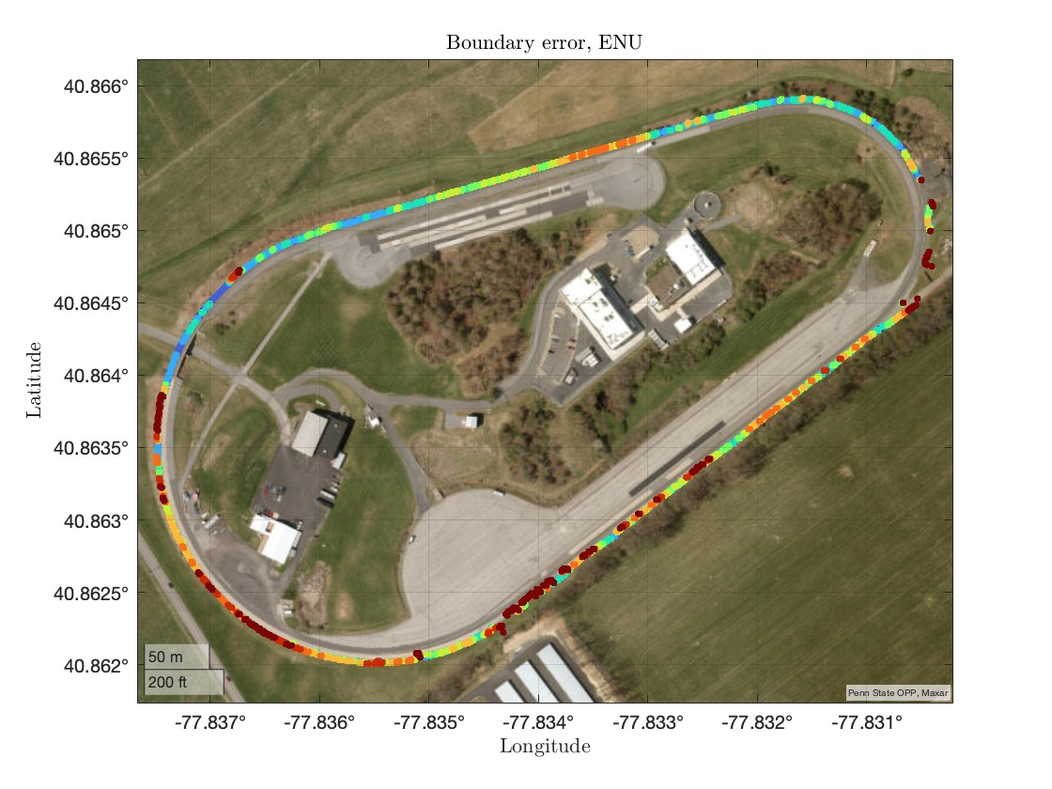
The histogram of the orthogonal distances from the hand-labeled points to computed boundary points is shown in the RHS. The LLA plot shows the test track with the computed boundary points classified based on the error magnitude. Red indicates a higher error, and blue indicates a lower error
Grid size = 1 meter

Slide 3
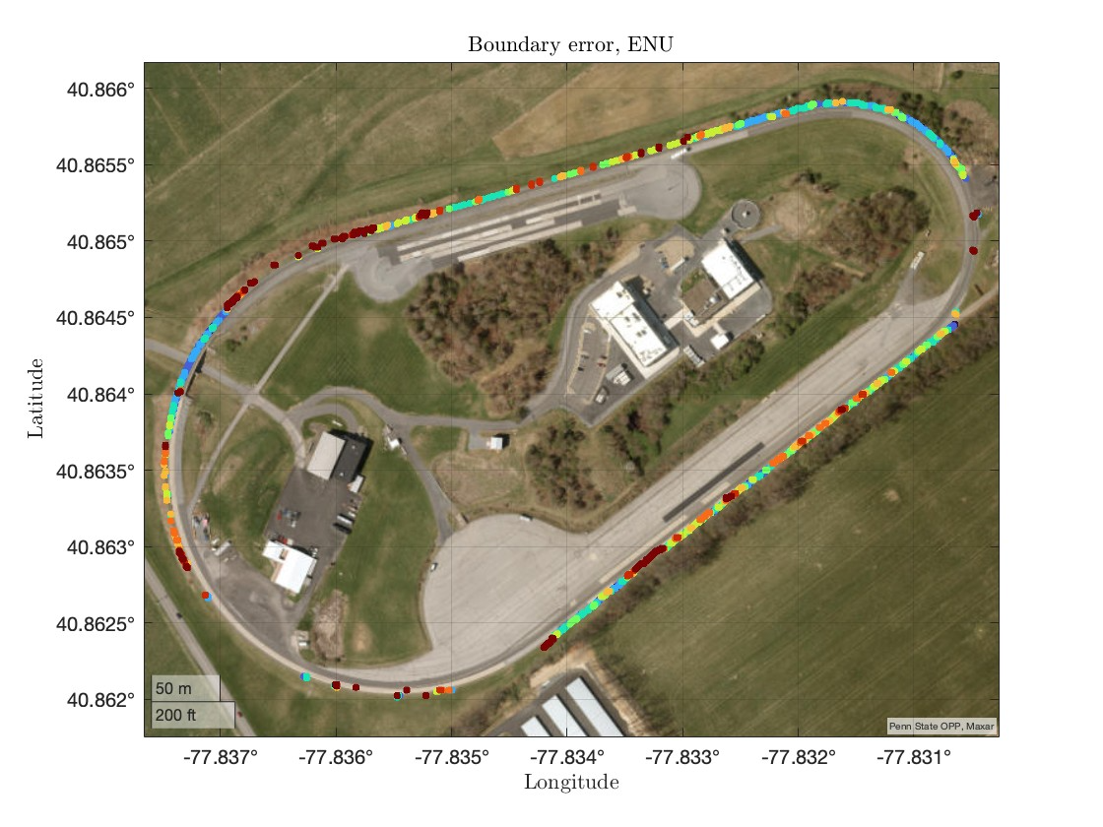
The histogram of the orthogonal distances from the hand-labeled points to computed boundary points is shown in the RHS. The LLA plot shows the test track with the computed boundary points classified based on the error magnitude. Red indicates a higher error, and blue indicates a lower error
Grid size = 1 meter

Slide 4
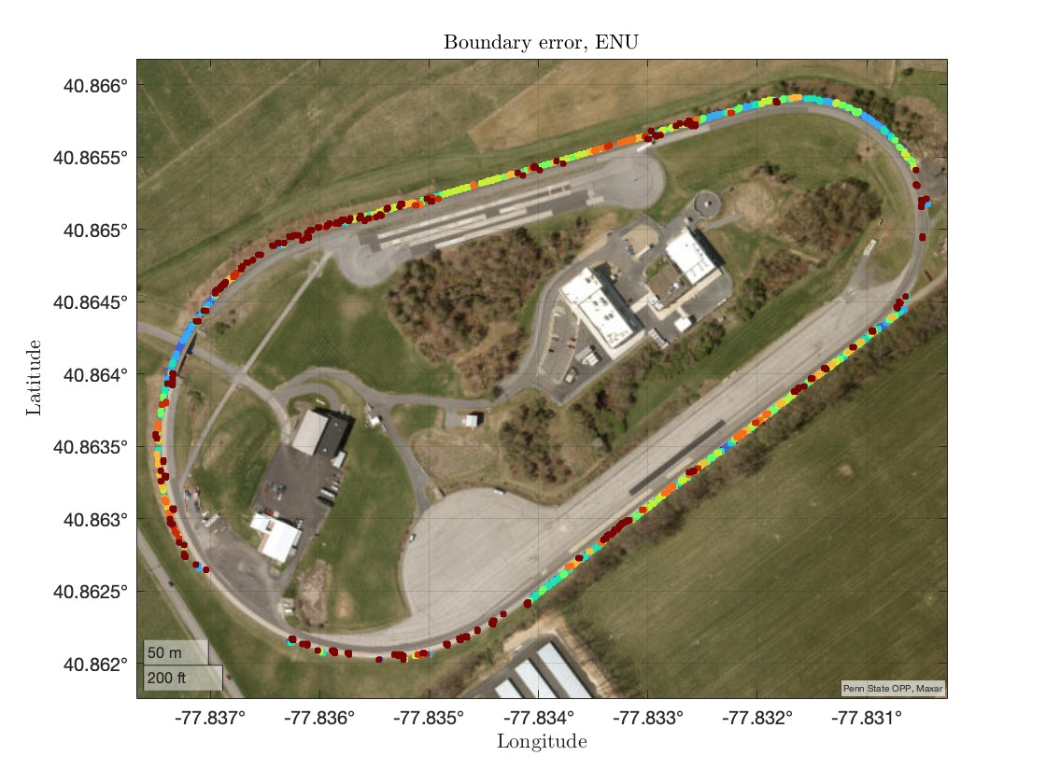
The histogram of the orthogonal distances from the hand-labeled points to computed boundary points is shown in the RHS. The LLA plot shows the test track with the computed boundary points classified based on the error magnitude. Red indicates a higher error, and blue indicates a lower error
Grid size = 1 meter

Slide 5
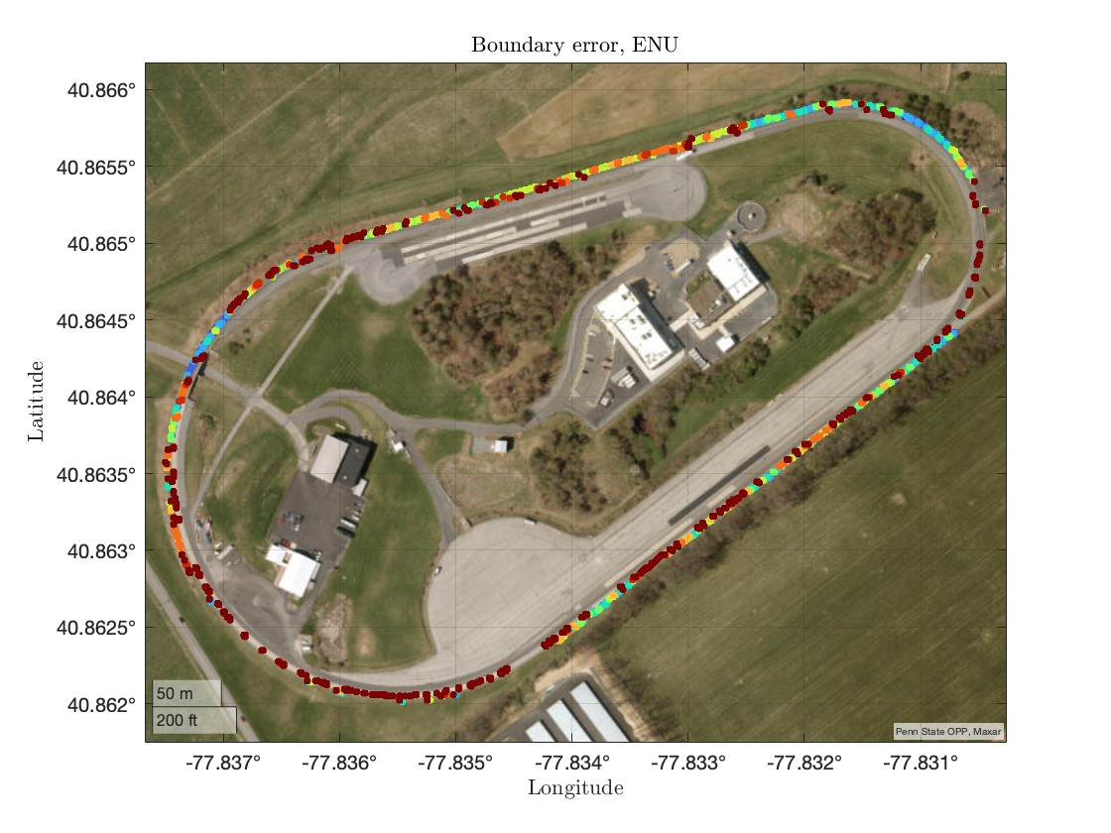
The histogram of the orthogonal distances from the hand-labeled points to computed boundary points is shown in the RHS. The LLA plot shows the test track with the computed boundary points classified based on the error magnitude. Red indicates a higher error, and blue indicates a lower error
Grid size = 1 meter

Slide 6
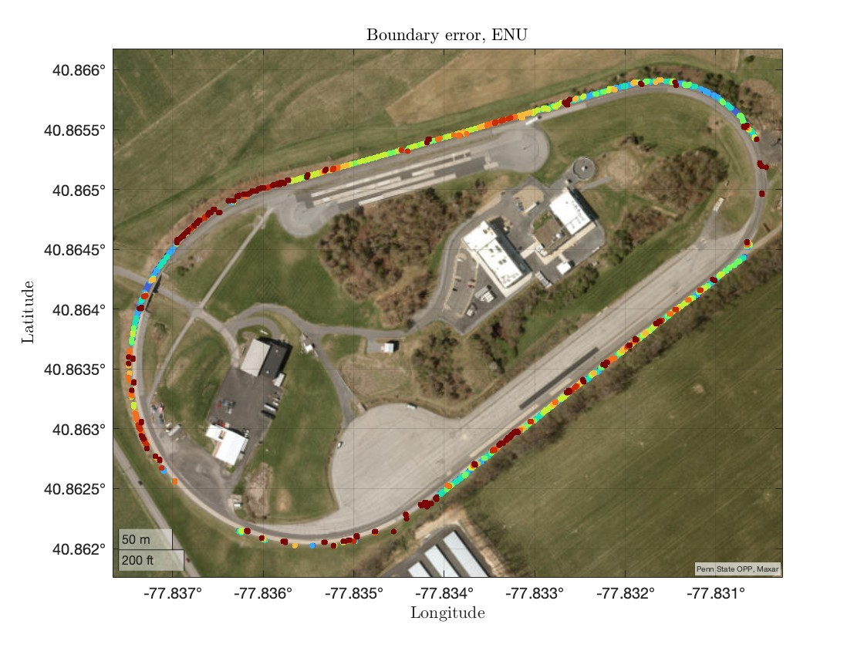
The histogram of the orthogonal distances from the hand-labeled points to computed boundary points is shown in the RHS. The LLA plot shows the test track with the computed boundary points classified based on the error magnitude. Red indicates a higher error, and blue indicates a lower error
Grid size = 1 meter

Slide 7
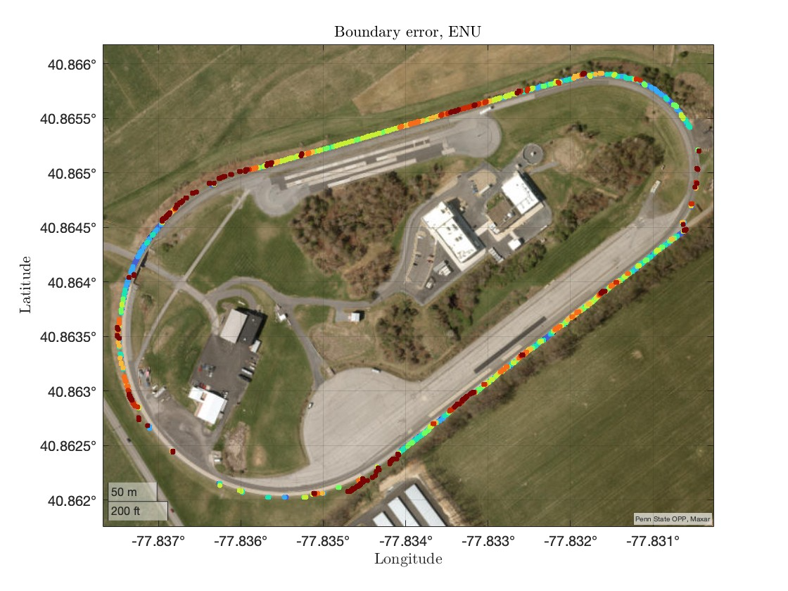
The histogram of the orthogonal distances from the hand-labeled points to computed boundary points is shown in the RHS. The LLA plot shows the test track with the computed boundary points classified based on the error magnitude. Red indicates a higher error, and blue indicates a lower error
Grid size = 1 meter

Slide 8

The histogram of the orthogonal distances from the hand-labeled points to computed boundary points is shown in the RHS. The LLA plot shows the test track with the computed boundary points classified based on the error magnitude. Red indicates a higher error, and blue indicates a lower error
Grid size = 1 meter

